Slide 1
Classifying Cybersecurity Incidents with Machine Learning

Slide 2
Project Overview
The **Classifying Cybersecurity Incidents ** project is a machine learning-based solution designed to enhance the efficiency of Security Operation Centers (SOCs). The project focuses on building a classification model that accurately predicts the triage grade of cybersecurity incidents, assisting SOC analysts in prioritizing their efforts and responding to threats efficiently.
The goal is to classify incidents as:
True Positive (TP): A confirmed threat.
Benign Positive (BP): A false alarm.
False Positive (FP): A misidentified threat

Slide 3
Key Features & Skills
This project allows you to dive deep into several crucial aspects of data science and machine learning:
Data Preprocessing & Feature Engineering: Cleaning and transforming raw data into useful features for model training.
Machine Learning Classification Techniques: Employing algorithms like Random Forest, XGBoost, and others for incident classification.
Evaluation Metrics: Using Macro-F1 Score, Precision, and Recall to assess model performance.
Cybersecurity Frameworks: Leveraging the MITRE ATT&CK framework for better understanding of cybersecurity data.
Handling Imbalanced Datasets: Implementing strategies like SMOTE, class weights, and ensemble methods to deal with imbalanced data.
Model Optimization: Fine-tuning model parameters for optimal performance

Slide 4
Business Use Cases
The developed solution can significantly improve multiple areas of cybersecurity operations:
Security Operations Centers (SOCs): Automates the triage process and enhances analysts' decision-making.
Incident Response Automation: Provides SOCs with faster, data-driven insights and recommended actions.
Threat Intelligence: Increases the precision of detecting true and false positives using historical data.
Enterprise Security Management: Reduces false positives, improves threat detection, and ensures swift incident response.

Slide 5
Project Approach
1. Data Exploration and Preprocessing
Initial Inspection: Load and examine the train dataset (train.csv) to understand the structure, data types, and distribution of the target variable.
Exploratory Data Analysis (EDA): Visualize patterns, identify correlations, and detect anomalies, particularly class imbalances.

Slide 6
2. Model Building
Train-Validation Split: Split the data into training and validation sets for effective model evaluation.
Baseline Model: Start with simple models (e.g., Logistic Regression, Decision Trees) to set a performance benchmark.
Advanced Models: Use Random Forest, XGBoost, LightGBM, and other sophisticated models for classification.
Cross-Validation: Implement k-fold cross-validation to ensure robustness.

Slide 7
3. Model Evaluation
Performance Metrics: Focus on Macro-F1 Score, Precision, and Recall to measure the model’s ability to generalize to unseen data.
Hyperparameter Tuning: Use techniques like Grid Search or Random Search to optimize model performance.
Handling Class Imbalance: Apply methods like SMOTE or adjust class weights to handle class imbalance.
4. Final Evaluation
Testing: Evaluate the final model using the test dataset (test.csv) and report key metrics.
Comparison to Baseline: Ensure the model’s performance outperforms the baseline and holds up on unseen data.

Slide 8
Results
Model Performance: A highly accurate classification model that predicts cybersecurity incident triage grades (TP, BP, FP).
Feature Analysis: Insights into which features influence model predictions the most.
Model Documentation: Comprehensive process documentation, highlighting each phase from data collection to model evaluation.

Slide 9
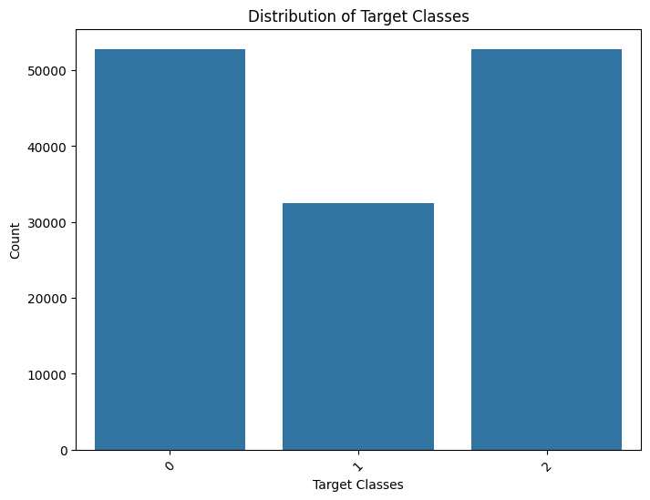

Slide 10
Evaluation Metrics
Macro-F1 Score: Balances precision and recall, providing a holistic view of performance across all classes.
Precision: Measures the proportion of true positive predictions out of all positive predictions.
Recall: Measures the model’s ability to identify all true positives, ensuring critical incidents are not missed.

Slide 11
Dataset Overview
The GUIDE dataset contains cybersecurity incident records annotated with triage grades (TP, BP, FP). The data is stratified and includes over 1 million triage-annotated incidents, ensuring a comprehensive representation of real-world security incidents.
Features:
Evidence: Individual pieces of evidence like IP addresses, emails, and user details.
Alerts: Aggregated evidence signaling a potential security incident.
Incidents: A collection of alerts representing a complete security threat scenario.

Slide 12
Usage
Load the data from train.csv and test.csv.
Preprocess and engineer features.
Train and evaluate your model.
Check model performance with key metrics (Macro-F1 Score, Precision, Recall).

Slide 13
Technologies Used
Python: Main programming language.
Pandas, NumPy: For data manipulation and processing.
Scikit-Learn: For building and evaluating machine learning models.
XGBoost, LightGBM: Advanced boosting algorithms.
Matplotlib, Seaborn: For data visualization and exploratory analysis.
SMOTE: Synthetic Minority Over-sampling Technique for class imbalance handling.

